Slide 1
Website map accessibility
Defra Accessibility Team
v1.1 Maps
Notes:
Good afternoon.
I’m Martin Glancy from the Defra Accessibility Team. My colleague Joe Lamyman is also on the call.
Is there anyone who can’t see these slides clearly?
[Describe yourself if needed].
Today I’ll be spending 10 minutes introducing website accessibility.
Let’s start with some facts about accessibility.

Slide 2
14 million disabled people in the UK
Notes:
14 million disabled people in the UK (Family Resources Survey: 2020)
That’s a lot of us.

Slide 3
1 in 12 males (8%) are colour blind
A total of 3 million people in the UK
Notes:
It’s about 1 in 200 for females.

Slide 4
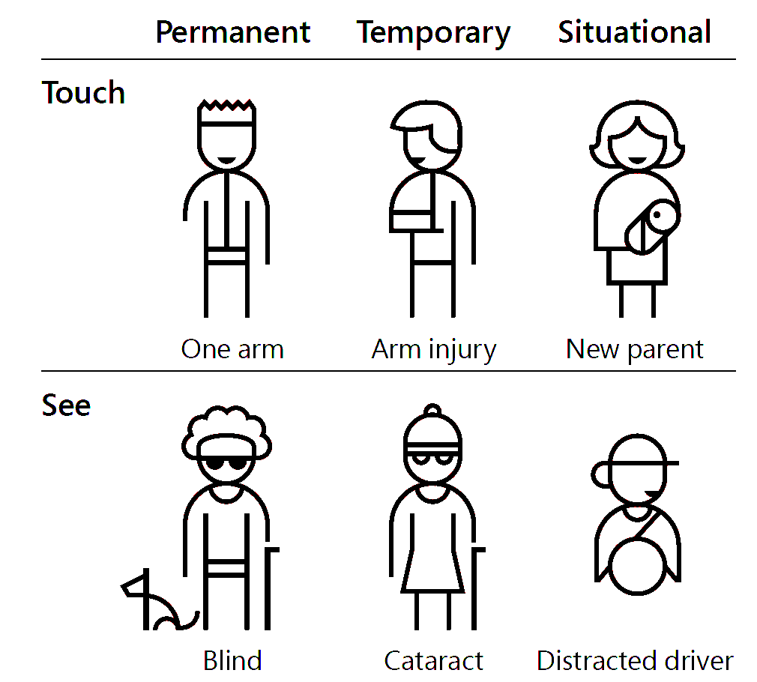
Not all disabilities are permanent
Notes:
Accessibility is not just about screen readers. You might:
break your arm or wrist
get repetitive strain injury (RSI)
injure an eye or develop an eye condition
You might prefer to use different screen colours
need to use the application on a phone or tablet (on a train, or whilst moving)
get older
Not all disabilities are permanent.

Slide 5
60% of people without disabilities use some kind of accessibility feature
Notes:
It may surprise you to know that 60% of people without disabilities use some kind of accessibility feature. For example, video captions, text zoom, dark mode, tabbing between form fields.
You probably use some of these.

Slide 6

Who do you want to exclude from using your website?
Notes:
So given all of the people who might benefit from accessibility
the question might be
- who do you want to exclude from using your website?

Slide 7
Accessibility is the law
Public sector websites must:
be accessible to level AA of the Web Content Accessibility Guidelines (WCAG) v2.1
publish an accessibility statement
‘Websites’ includes intranets, extranets, outsourced sites, SaaS, mobile apps and staff-only applications.
Notes:
Regulations came into force in September 2018 - 3 years ago. Websites that existed before the act had until last September to comply. Mobile apps compliant by June 2021.
There’s guidance on GOV.UK.

Slide 8
Maps are exempt, aren’t they?
Notes:
But hang on… maps are exempt, aren’t they?
The public sector requirements do provide for an exemption for “online maps and mapping services”
It’s a little more complicated than that.

Slide 9
Equality Act 2010
GDS Service Standard
Public Sector Regulations
The rest of your site isn’t exempt
Notes:
Equality Act came into force 11 years ago. It’s still the overriding legislation for accessibility.
The GDS Service Standard may apply to your service. It pre-dates the public sector regulations. It may apply through spend control for some projects.
The maps exemption was intended for very small public bodies such as small councils, not for large well-funded bodies.
It’s our position that you should aim to not rely on that exemption. In any case, the rest of your site isn’t exempt - so search, text, documents etc - And in addition to the map you’ll need to provide essential information in an accessible digital format.

Slide 10

Making maps accessible is hard
Notes:
Making maps accessible is hard - given the current state of the art.
And they are used for a number of functions - to display information, as an interface for location and for both when querying data sets.
I’m not aiming to give detailed guidance in 10 minutes but here are a few thoughts about an approach.

Slide 11
1. It’s not always about the map
What task does the user need to do?

Slide 12
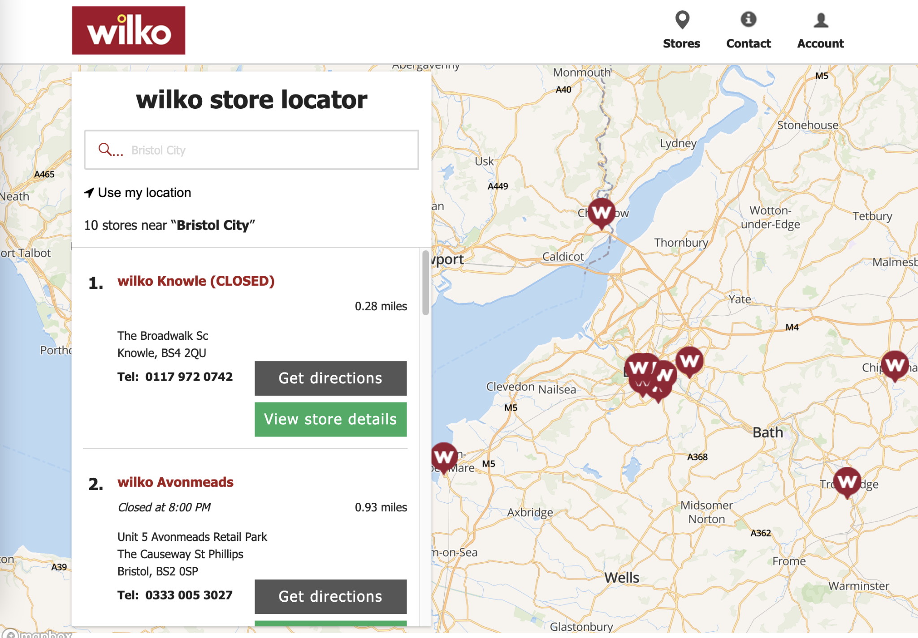
Notes:
I can search using many different ways of giving a location. The map’s not the main interface.
I appreciate that not all mapping functions will work in this simple way but do try to provide accessible ways to avoid things like clicking on a map.

Slide 13
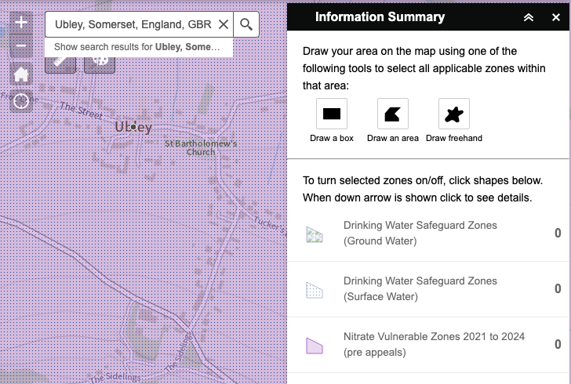
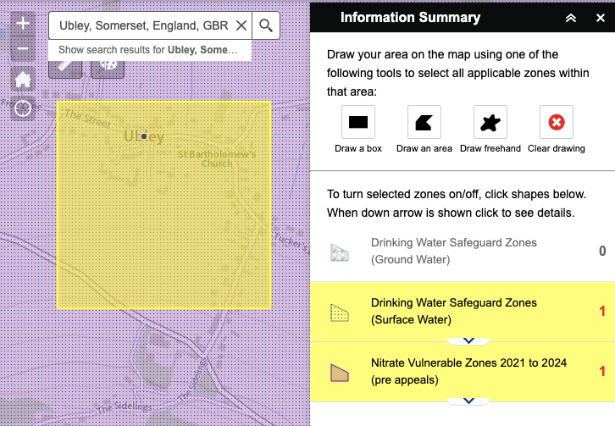
Notes:
This might be a slightly unfair example - I won’t name it -
I can search for a place and it’s found but I don’t get any indication tht there’s relevant information unless I draw a shape.

Slide 14
Can I...
give a location without clicking on a map?
get the results of a query without seeing a map?
access documents without drawing a polygon?
Notes:
Location: postcode, region, placename, grid reference, device location, a reference number from another system.
Get the results of a query: yes, you can apply for permit here; no, there are no water action plans here.
Document: here’s a list of all the marine plans for sea area dogger bank

Slide 15
2. Make it more accessible even if it’s not fully accessible

Slide 16
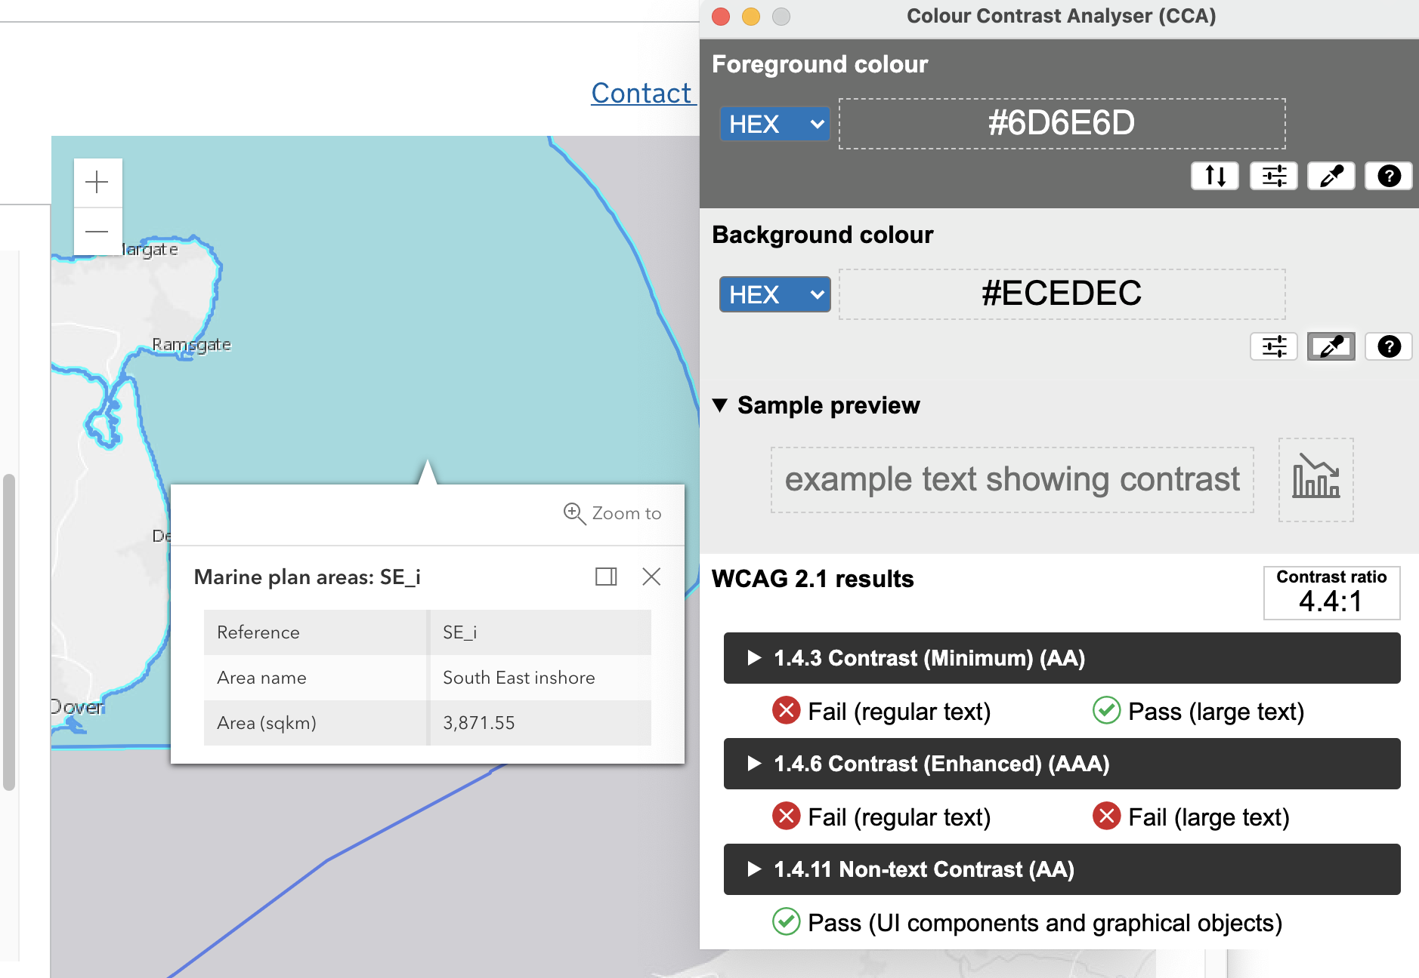
Notes:
This text is tiny and the contrast is poor.

Slide 17
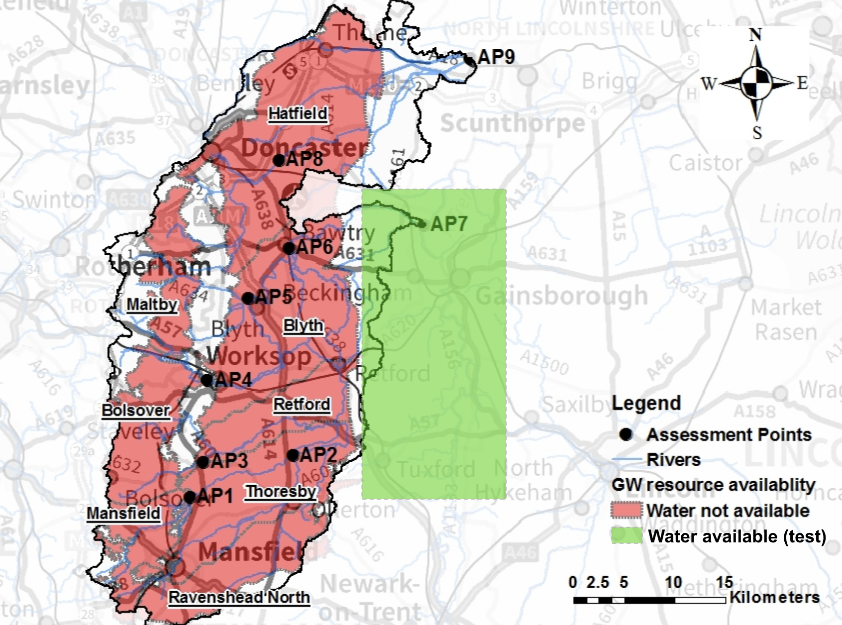
Notes:
Could this map be made clearer for people with poor vision? Is the choice of colours OK for people with colour blindness?

Slide 18
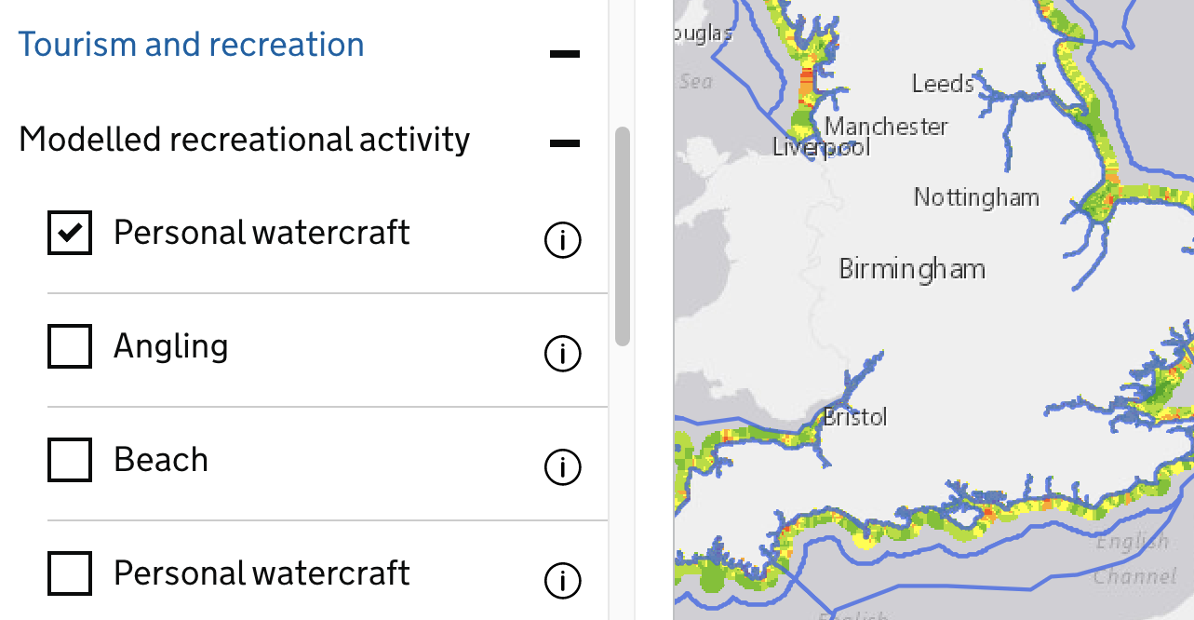
Notes:
The first iteration of these filter controls did not work with the keyboard.
The current iteration does.

Slide 19
3. Get it tested and learn how to do basic checks yourself
Notes:
You won’t know if it’s accessible unless you get it tested.
Basic checks you can do:
Operate with keyboard only
Zooming the text
Correct use of links and headings
Checking for basic plain English
“Eat your own dog food” - try a typical user journey, including triggering errors
Try it on different screens, tablets and mobiles
Check for timeouts or popups that can’t easily be disabled

Slide 20
4. Ask the ‘A’ question
Is this accessible??
Notes:
If other people are working with you:
Defining requirements
Supplying content
Creating text or documents
Ask the ‘A’ question - is this accessible? Has it been checked?

Slide 21
In summary
Make the task and information accessible, even if the map isn’t.
Get an accessibility audit done.
Make a plan to fix any issues.
Publish an accessibility statement using the GDS template.
Notes:
These are the things you need to do.

Slide 22
Get advice
There’s excellent guidance on GOV.UK.
If you need help or advice contact us accessibility@defra.gov.uk

